Slide 1
The EURODIPLOMATS Methodological Tool
‘Εmpowering children to act as cultural diplomats for a robust and resilient Europe’
EURODIPLOMATS
Project reference: KA227-226D6961

Slide 2
What are the methodological tools used in the EURODIPLOMATS project?
Collaborative art-making pedagogy
Collaborative art-making and poetry pedagogy
Digital-culture pedagogy

Slide 3
Collaborative art-making pedagogy
Collaborative art-making entails children’s collaborative work in order to achieve a common goal within their art group, while learning to share their thoughts (i.e. on culture, art, and language) and emotions, and use critical thought to go into the others’ emotions.
Collaborative art-making may be used as an innovative and more creative research method to examine children’s everyday life, experiences, and social interactions. In such a method, children should become co-interpreters of their art creations by being encouraged to comment upon them.

Slide 4
Why is collaborative art-making pedagogy important for empowering students as cultural diplomats?
Collaborative art-making:
helps teachers to effectively instill to students intercultural values like respect to the ‘other’ and acceptance of difference (Hajisoteriou & Angelides, 2017).
helps students see things differently, and thus certain power relations (economic, gendered, ethnic) can be altered (Cooper & Sjostrom, 2006).
helps students to come closer to each other, understand each other’s emotions, see their peers from a human perspective, and think harder about other people regardless of race, ethnicity or social class (Rubin, 1997).

Slide 5
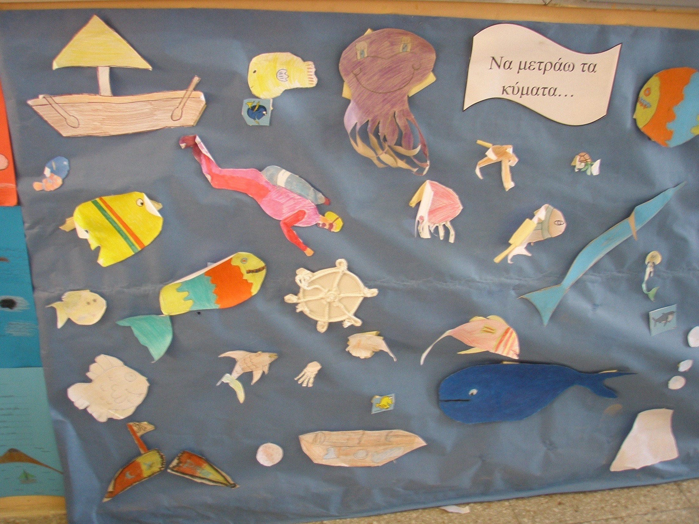
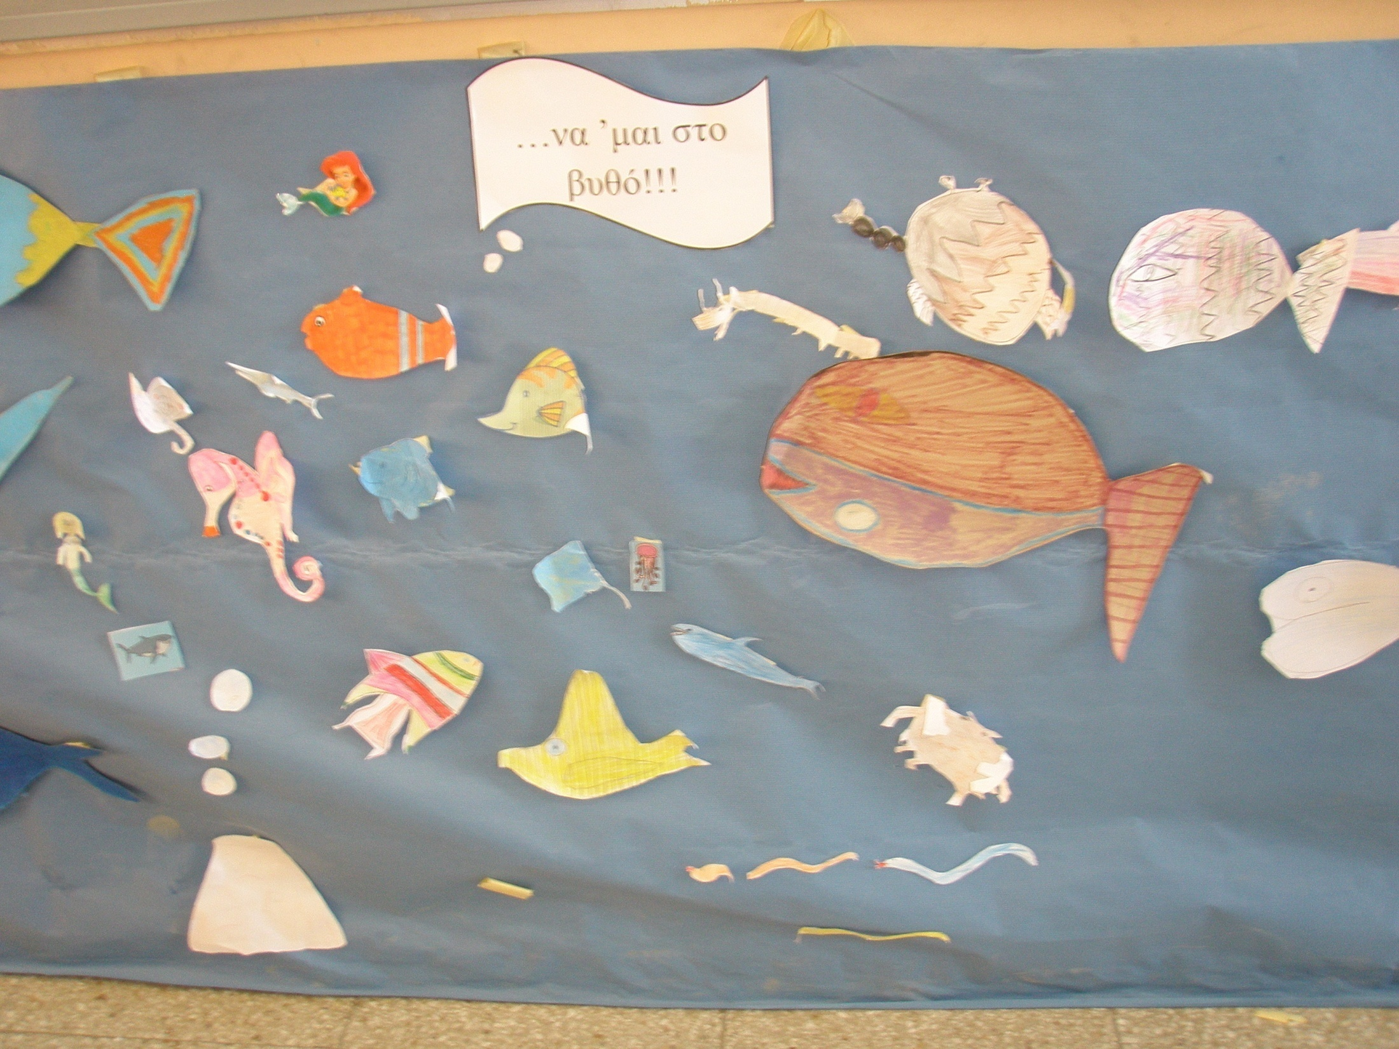
Collaborative art-creations as ‘voices’ of activism for a specific cause (e.g. the protection of European seas)

Slide 6
Collaborative storytelling and poetry pedagogy
During collaborative storytelling or poetry, tellers bring different ideas and coordinate with each other trying to create a coherent story or poem.
Collaborative storytelling can be developed in linear and nonlinear approaches.
Linear stories contain exactly one begin, one middle and one end. All children collaborate on a shared story in the form of relay and no branches can be developed. Children deeply rely on evaluating the relationship, continuality and coherence of story path before sequentially participating in building up the story.
Nonlinear stories enable children to link and orchestrate different ideas. Children can thus integrate other’s episodes to develop different branches of stories.

Slide 7
A step-by-step approach to collaborative storytelling/poetry
STEPS:
Students contribute their ideas in a shared pool, from where they can also retrieve ideas from others.
Students refine or elaborate elements contributed by others with personal ideas.
Students retrieve and organise the selected elements from the shared pool and individually orchestrate those elements by linking to form a story path.
Students combine assorted contributions to create a personal story version. (Liu et al., 2010)

Slide 8
Students create multiple story versions, while they can also modify stories created by their peers.
Students integrate vocal or written narratives to elaborate a story consisted of orchestrated elements. A story can be multiply interpreted with different voices and tones.
After the finalised story is published, students receive other viewer’s comments. The feedback facilitates children to reflect on their story.
Students can then modify the published story based on comments for advancement. (Liu et al., 2010)

Slide 9
Collaborative storytelling prompts used by teachers

Slide 10
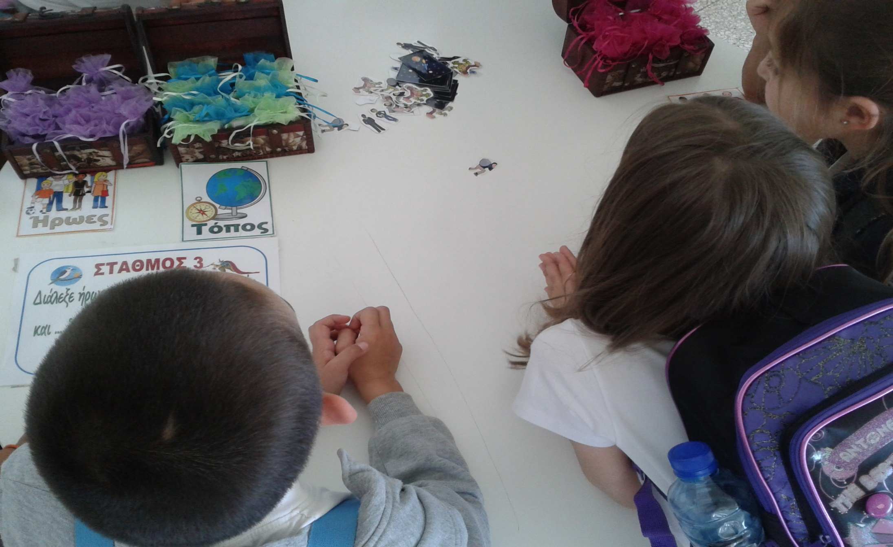
Example of Activity: Students create collaborative stories and poems through the use of prompts.
Select your heroes
Select the place

Slide 11
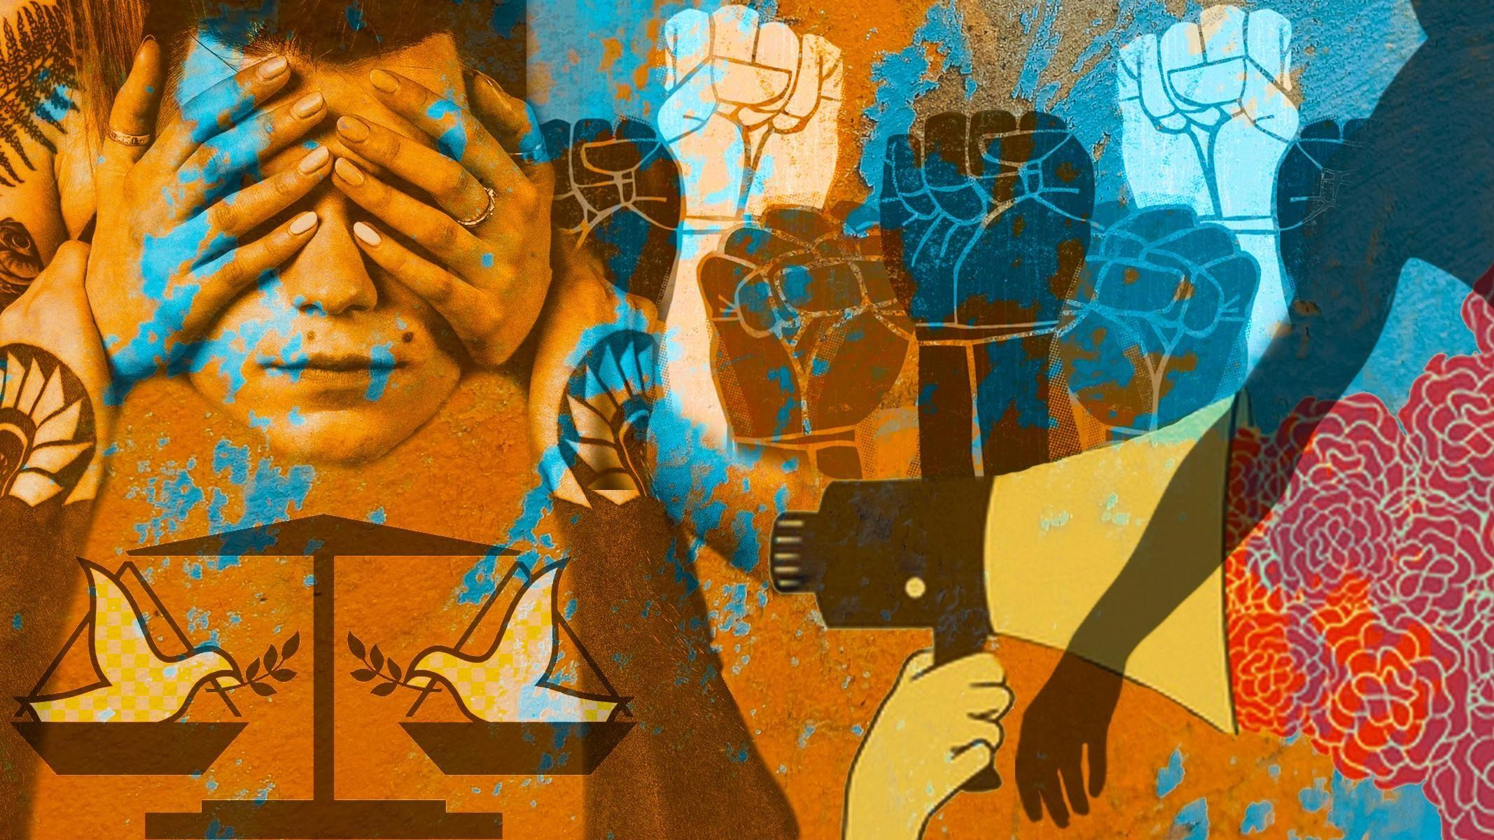
An example: The ‘Silent Statues’
Collaborative embodiment of cultural values and collaborative storytelling on these ‘silent statues’.

Slide 12
Digital-culture pedagogy
According to digital-cultural pedagogy, the EURODIPLOMATS project will produce activities and resources enabling children to participate in online environments to produce projects focusing on the intersection of cultural diplomacy and European social cohesion and resilience.
Examples of online communication tools to be used are software, videoconferencing and discussion forums, etc.
In this pool of activities, we can also focus on promoting digital culture through our activities.

Slide 13
Digital-culture pedagogy: Tools
Online critical incident analysis: critical incidents ‘are shorter than case studies and refer to cross-cultural misunderstandings, problems and clashes. The incidents do not illustrate the cultural differences of the interacting parties; rather these are discovered as the activity is carried out. The use of critical incidents can bring about pupils’ understanding of their own personal and cultural identity’ (Flowler & Blohm (2004: 37-84).
Students communicate online with professional communities that work in the field of cultural diplomacy.

Slide 14
Digital-culture pedagogy: Tools
Tele-teams with other schools to produce projects on topics interconnecting cultural diplomacy and European collaboration in facing shared European challenges and threat (i.e. environmental sustainability; peace in Europe; social inclusion; healthier lifestyles for Europeans).
Students act as cultural diplomats on e-forums including chat rooms and emailing.
Tele-presentations through video-conferencing (use of photographs, videos, audio narrations, and other means of technology).

Slide 15
Thank you!

