Slide 1
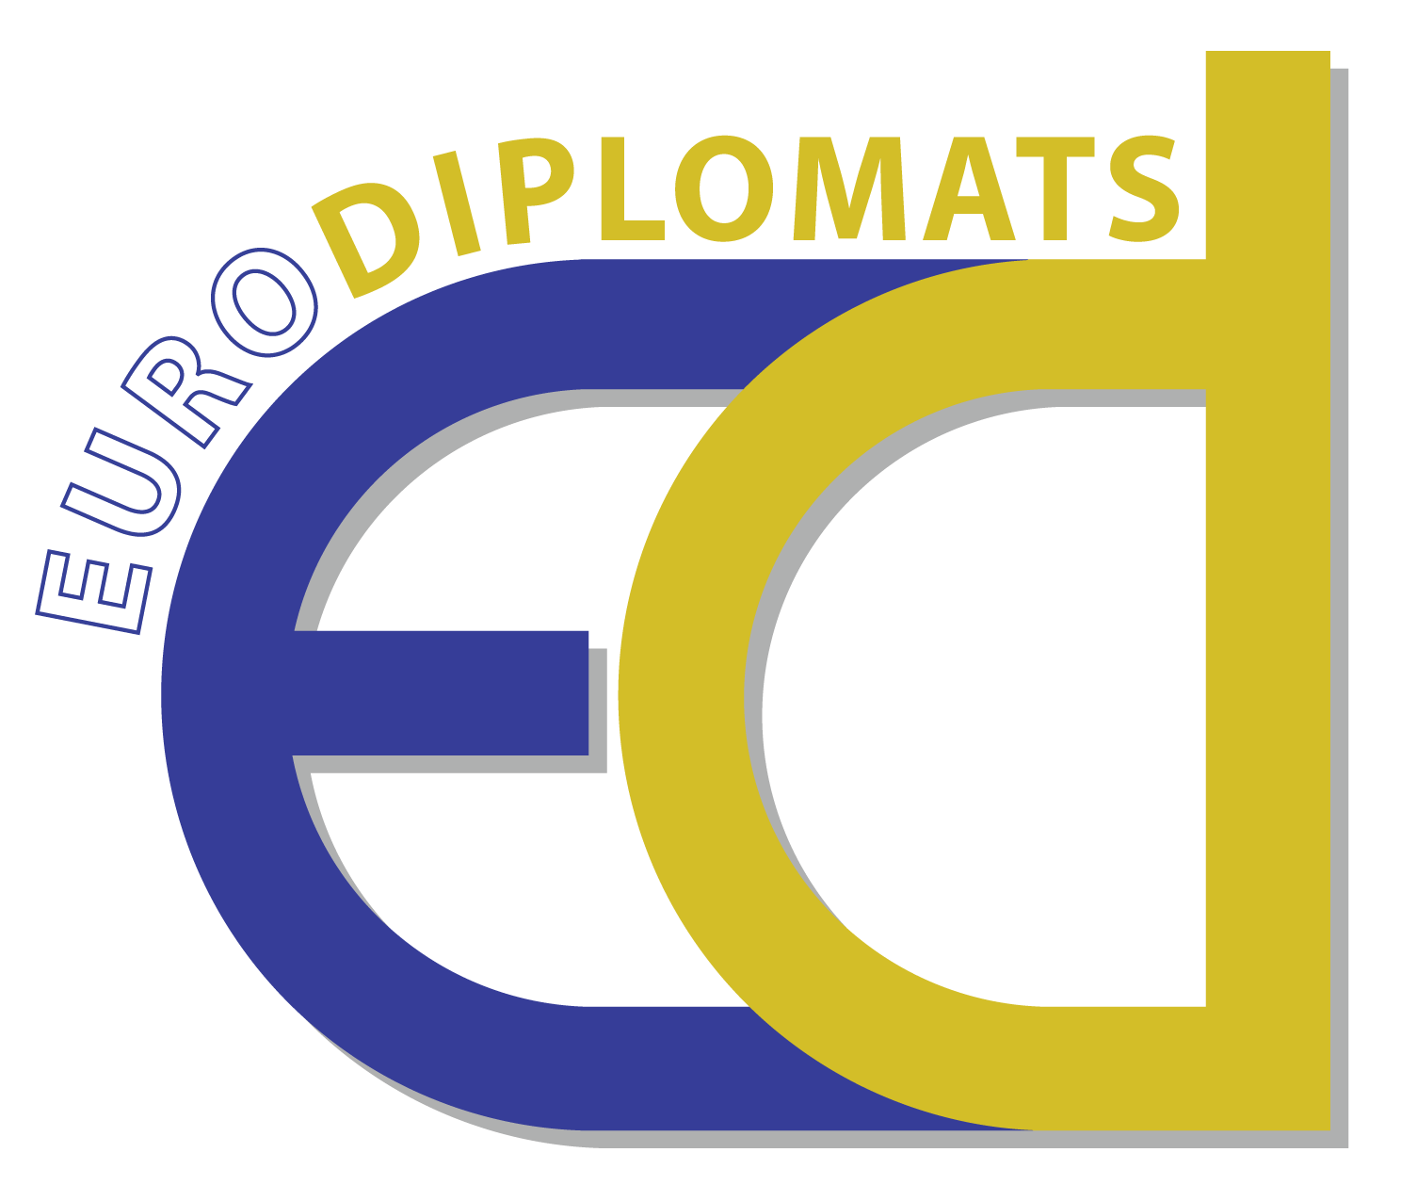
Content of the project
‘Εmpowering children to act as cultural diplomats for a robust and resilient Europe’
EURODIPLOMATS
Project reference: KA227-226D6961

Slide 2
The context of the project
The EU is facing several severe crises, such as the Covid-19 pandemic, the subsequent socio-economic crisis, the refugee crisis, and tensions between some of its Member States and third countries.
To successfully deal with any crisis, ultimate victory is proof that Europe can successfully overcome any cultural or other differences between its people to become socially cohesive and resilient to meet current and new threats and challenges. Cultural diplomacy can be the vehicle leading to this victory, as it has the unique advantage of helping people to adapt more quickly to the demands of rapid change and the increased speed of change.
Over the last few years, the EU has paid increased attention to fostering dialogue with children about the ways to manage such challenging situations of crisis. In 2017, the European Parliament held a debate with children and young people about the ‘Europe we want’. The Eurochild established its Child Participation Strategy to put children at the heart of Europe by giving them the right and the tools for advocacy and voice.

Slide 3
What are the aims of this project?
The first goal of the project is to enable children to become cultural diplomats so as to act as agents of change in order to build a socially cohesive and resilient Europe capable of meeting new threats and challenges.
The achievement of the goal is based on the approach of cultural diplomacy, and the use of new technologies and innovative and creative methodologies, such as collaborative art-making, collaborative storytelling and poetry, and digital-cultural pedagogies.
Another important goal of this project is to promote children's and teachers' training to improve their skills to become agents of the cultural diplomacy approach, in order to achieve the first goal of the project.

Slide 4
Why is this project innovative?
The very topic of the project and the area it addresses is innovative, as the EURODIPLOMATS project brings together social cohesion and resilience in Europe with children's enactment of cultural diplomacy as a form of active citizenship.
Thus, the project is innovative because it aims to build a Europe of social cohesion, robustness, and resilience through a route that has not been used in the past in school education, that of cultural diplomacy.
Although many projects have focused on children's cultural citizenship in the past, no projects have been developed and implemented about cultivating children's skills in cultural diplomacy.
The EURODIPLOMATS methodology is an innovation by itself as it will improve teaching and learning. Accordingly, the innovation of the project also lies in the use of new technologies, and innovative and creative methodologies, such as collaborative art-making pedagogy, collaborative storytelling and poetry pedagogy, and digital-culture pedagogy.

Slide 5
The field: CULTURAL DIPLOMACY
According to the EU, culture is both tangible and intangible, natural, and digital. Thus, we have chosen to focus on cultural diplomacy through the fields of arts, literature and poetry, but also technology. All the produced activities and resources will aim to cultivate all participating children's competence and other soft skills in cultural diplomacy so as to become agents of change for building a multicultural Europe of resilience and social cohesion, which is able to meet new challenges, threats, and crises.

Slide 6
What is cultural diplomacy?
Cultural diplomacy entails a type of public diplomacy and soft power that refers to the exchange of ideas, information, art, language, and other aspects of culture among nations and their peoples in order to foster mutual understanding and cooperation.
The goal of cultural diplomacy is for people coming from a foreign nation to develop a rich understanding of one nation's ideals and institutions so as to build broad support for social, economic, and political goals.
Cultural diplomacy is a course of action based on the exchange of ideas, values, traditions, and other aspects of culture or identity, to strengthen relationships and socio-cultural cooperation, to promote national interests and beyond.

Slide 7
Comparing cultural and public diplomacies
(Villanueva, 2007)

Slide 8
The aims goal of cultural diplomacy
The aims of cultural diplomacy is to positively influence a foreign audience and use that influence, as a means for building mutual understanding, by:
building a positive view of the country's people, culture, and policies,
inducing greater cooperation between the two nations,
supporting change in socio-political policies of the target nation, and
preventing and mitigating conflict.

Slide 9
What is the main field of this project?
Children’s voice is a construct that includes the ways in which young people have the opportunity to meaningfully and actively engage in important decisions that have a considerable impact upon their lives.
Cultural diversity highlights the dynamic nature of cultures which are an unstable mixture of not only sameness but also otherness (Zabata-Barrero, 2017).
It suggests familiarising with the principles of democracy, mutual-understanding, and authentic interest in understanding of other cultures, humanitarian accountability of self and others and concern for marginalised groups within and beyond society.

Slide 10
Axes of the project
The field
Cultural diplomacy
/ Art, language, and other aspects of culture
The approach
Children voices
The methodological tools used
Collaborative art-making
Collaborative story-telling and poetry
Digital-cultural pedagogies

Slide 11
Thank you!

